Slide 1
Azure Automation

Slide 2
Agenda
Why need to Work with Azure Automation
Azure Automation management tools
Resource Management
What is Azure Automation
Use Cases for Automation on Azure
Lab time
Conclusion

Slide 3
Why need to Work with Azure Automation

Slide 4



Application on Azure
Deploy
Website
Application

Slide 5
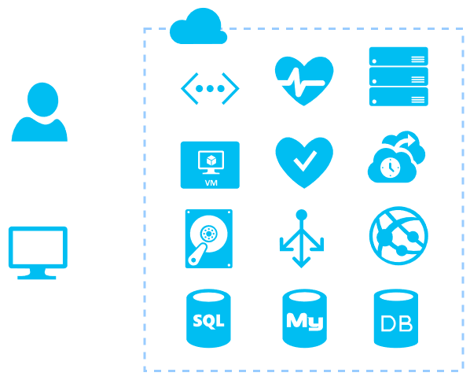
Build all Resource by yourself

Slide 6

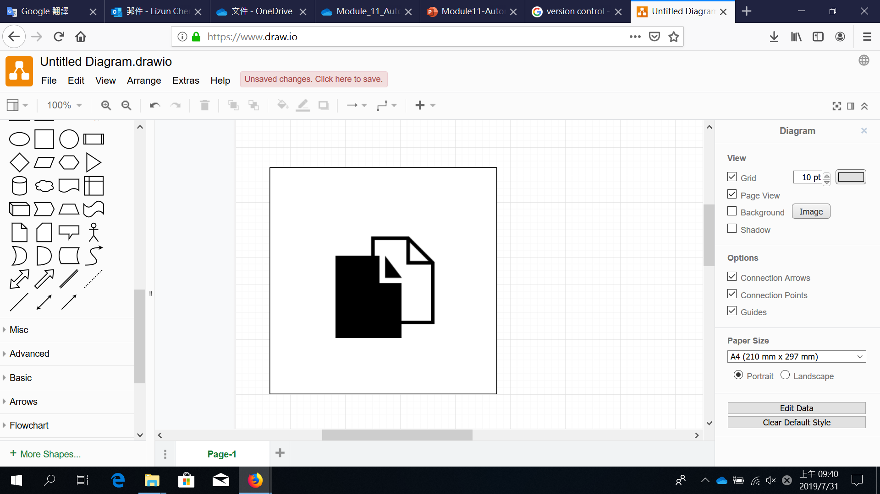
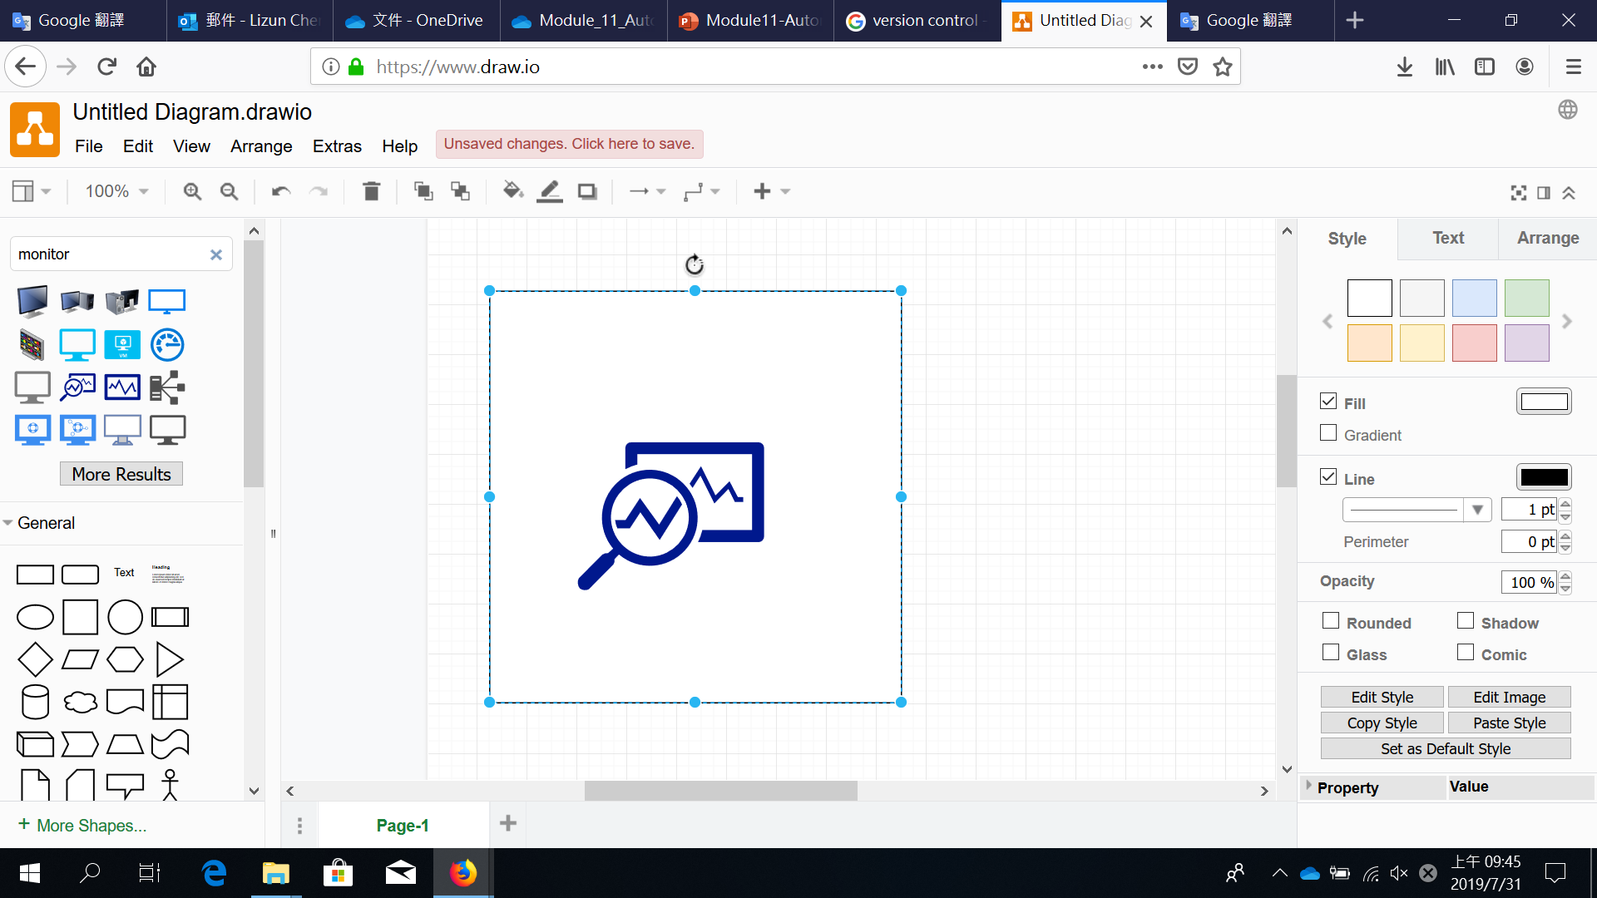
How about risk?
Couldn't Scaling
Version control
Monitor

Slide 7

Most Important
If you have to manually control most of the things in your environment,
you are putting yourself at risks.

Slide 8

Automation service is a better option

Slide 9



Automation can help you
To minimize manual interaction
and human errors
To replicate processes consistently
and with better quality than a human
Minimize costs due to
manual errors and inefficiency

Slide 10

The Benefits of Azure Automation
Integrates with other system by building a PowerShell integration modules
Accelerates the flexible workflow process
Improves reliability in service among different tools, systems, and departments
Reduces manual activities in detecting errors and corrections
Adjust scalability according to the usage that means

Slide 11
Azure automation management tools

Slide 12




Azure automation management tools
Azure Portal
A website that you can access with a web browser
Azure cli
A cross-platform command-line program that connects to Azure and executes administrative commands on Azure resources
Cross platform means that it can be run on Windows, Linux, or macOS
Azure PowerShell
A module that you add to Windows PowerShell or PowerShell Core that enables you to connect to your Azure subscription and manage resources
Azure Cloud Shell
Browser-based scripting environment in your portal
Provides the flexibility of choosing the shell experience that best suits the way you work

Slide 13
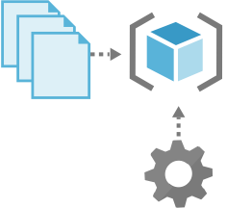
ARM Templates
Automatically provision infrastructure
Create webhooks that allow secure interaction with elements of the environment
Use the template for updates to the infrastructure

Slide 14

Azure DevOps
Use Azure DevOps pipeline
Integrate automation into a CI/CD pipeline
Control the automation code development and deployment
Use Azure Pipelines to deploy code to multiple targets

Slide 15
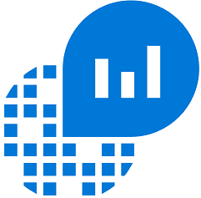
Log analytics
Web tool used to write and execute Azure Monitor log queries
Collect, correlate, search, and act on log and performance data
Primary tool in the Azure portal for writing log queries and interactively analyzing
Notes:
LogAnalytics是一個用於編寫和執行Azure Monitor log queries的Web工具。
LogAnalytics幫助您收集、關聯、搜索從OS和application所生成的日誌和性能數據。它為您提供了即時的操作洞悉，輕鬆地分析所有工作負載和服務器中的數百萬條記錄，而不管它們的物理位置如何。LogAnalytics為您提供了一個用於消費和關聯數據的接口，涵蓋Linux和WindowsServer。
LogAnalytics是Azure portal中用於編寫log queries和交互分析其結果的主要工具。即使在Azure Monitor的其他地方使用log quereis，通常也會首先使用LogAnalytics編寫和測試查詢。
——————————————————————————
Log Analytics is a web tool used to write and execute Azure Monitor log queries.
Log Analytics helps you collect, correlate, search, and act on log and performance data generated by operating systems and applications. It gives you real-time operational insights using integrated search and custom dashboards to readily analyze millions of records across all your workloads and servers regardless of their physical location. Log Analytics gives you a single interface for consuming and correlating the data, covering both Linux and Windows Server.
Log Analytics is the primary tool in the Azure portal for writing log queries and interactively analyzing their results. Even if a log query is used elsewhere in Azure Monitor, you'll typically write and test the query first using Log Analytics.
LogAnalytics是一個用於編寫和執行Azure Monitor log queries的Web工具。
LogAnalytics幫助您收集、關聯、搜索從OS和application所生成的日誌和性能數據。它為您提供了即時的操作洞悉，輕鬆地分析所有工作負載和服務器中的數百萬條記錄，而不管它們的物理位置如何。LogAnalytics為您提供了一個用於消費和關聯數據的接口，涵蓋Linux和WindowsServer。
LogAnalytics是Azure portal中用於編寫log queries和交互分析其結果的主要工具。即使在Azure Monitor的其他地方使用log quereis，通常也會首先使用LogAnalytics編寫和測試查詢。

Slide 16


Log queries
fully leverage the value of the data
powerful query language
Written using Kusto query language (KQL), a rich language designed to be easy to read and author.
Notes:
Log queries幫助您利用Azure Monitor Logs所手機收集的數據。強大的查詢語言允許您連接來自多個表的數據，聚合大量數據集，並以最少的代碼執行複雜的操作。只要收集到相關數據，幾乎任何問題都可以回答並執行分析，並且您了解如何構造正確的查詢。
Azure Monitor Logs是基于Azure Data Explorer，log queries使用相同的Kusto query language编写。这是一种设计成易于阅读和编写的丰富语言，我們能够在最低限度的指导下开始使用它。
——————————————————————————
Log queries help you to fully leverage the value of the data collected in Azure Monitor Logs. A powerful query language allows you to join data from multiple tables, aggregate large sets of data, and perform complex operations with minimal code. Virtually any question can be answered and analysis performed as long as the supporting data has been collected, and you understand how to construct the right query.
日誌查詢幫助您充分利用Azure Monitor日誌中收集的數據的值。強大的查詢語言允許您連接來自多個表的數據，聚合大量數據集，並以最少的代碼執行複雜的操作。只要收集了支持數據，幾乎任何問題都可以回答並執行分析，並且您了解如何構造正確的查詢。
Some features in Azure Monitor such as insights and solutions process log data without exposing you to the underlying queries. To fully leverage other features of Azure Monitor, you should understand how queries are constructed and how you can use them to interactively analyze data in Azure Monitor Logs. Use this article as a starting point to learning about log queries in Azure Monitor. It answers common questions and provides links to other documentation that provides further details and lessons.
Azure Monitor中的一些特性，如洞察力和解决方案，可以处理日志数据，而不会将您暴露在底层查询中。要充分利用Azure Monitor的其他功能，您应该了解查询是如何构造的，以及如何使用它们来交互分析Azure Monitor日志中的数据。使用本文作为学习Azure Monitor中的日志查询的起点。它回答了常见的问题，并提供了指向提供进一步细节和经验教训的其他文档的链接。
Azure Monitor Logs is based on Azure Data Explorer, and log queries are written using the same Kusto query language. This is a rich language designed to be easy to read and author, and you should be able to start using it with minimal guidance.
Azure Monitor日志基于Azure Data Explorer，日志查询使用相同的Kusto query language编写。这是一种设计成易于阅读和编写的丰富语言，您应该能够在最低限度的指导下开始使用它。

Slide 17


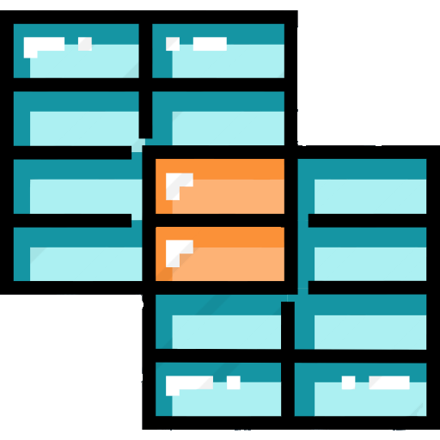
What data is available to log queries?
ALL
All data collected in Azure Monitor Logs is available to retrieve and analyze in log queries
All data collected in Azure Monitor Logs is available to retrieve and analyze in log queries
All data collected in Azure Monitor Logs is available to retrieve and analyze in log queries
Notes:
Azure Monitor Logs收集的所有數據都可以在log queries提取和分析。
不同的數據來源會写入不同的表，但可以在耽擱查询中涵蓋多个表，以分析跨多个數據源的數據。
在构建查询时，首先确定哪些表具有要查找的数据，因此您至少应该对Azure Monitor日志中的数据是如何构造的有基本的了解。
——————————————————————————
All data collected in Azure Monitor Logs is available to retrieve and analyze in log queries. Different data sources will write their data to different tables, but you can include multiple tables in a single query to analyze data across multiple sources. When you build a query, you start by determining which tables have the data that you're looking for, so you should have at least a basic understanding of how data in Azure Monitor Logs is structured.

Slide 18


Azure Log Analytics with Automation
Automation can send runbook job streams to Log Analytics workspace
Visible in the Azure portal
Use PowerShell for individual jobs search
Trigger an email or alert based on your runbook job status

Slide 19

Ansible
Use SSH to connect the managed node (Server).
Infrastructure as Code
Extremely simplified configuration language
Manage various clouds without modification
Notes:
86/5000
使用SSH連接到服務器
極其簡化的配置語言 無需修改即可管理各種雲

Slide 20

Chef
Ruby's domain-specific language (Domain Specific Language，DSL)
Infrastructure as Code
Manage the "recipe" and "cookbooks"
Easily work with other IaC tools
Notes:
Ruby的領域特殊語言
儲存系統組態「烹飪recipes」或「食譜cookbooks」

Slide 21
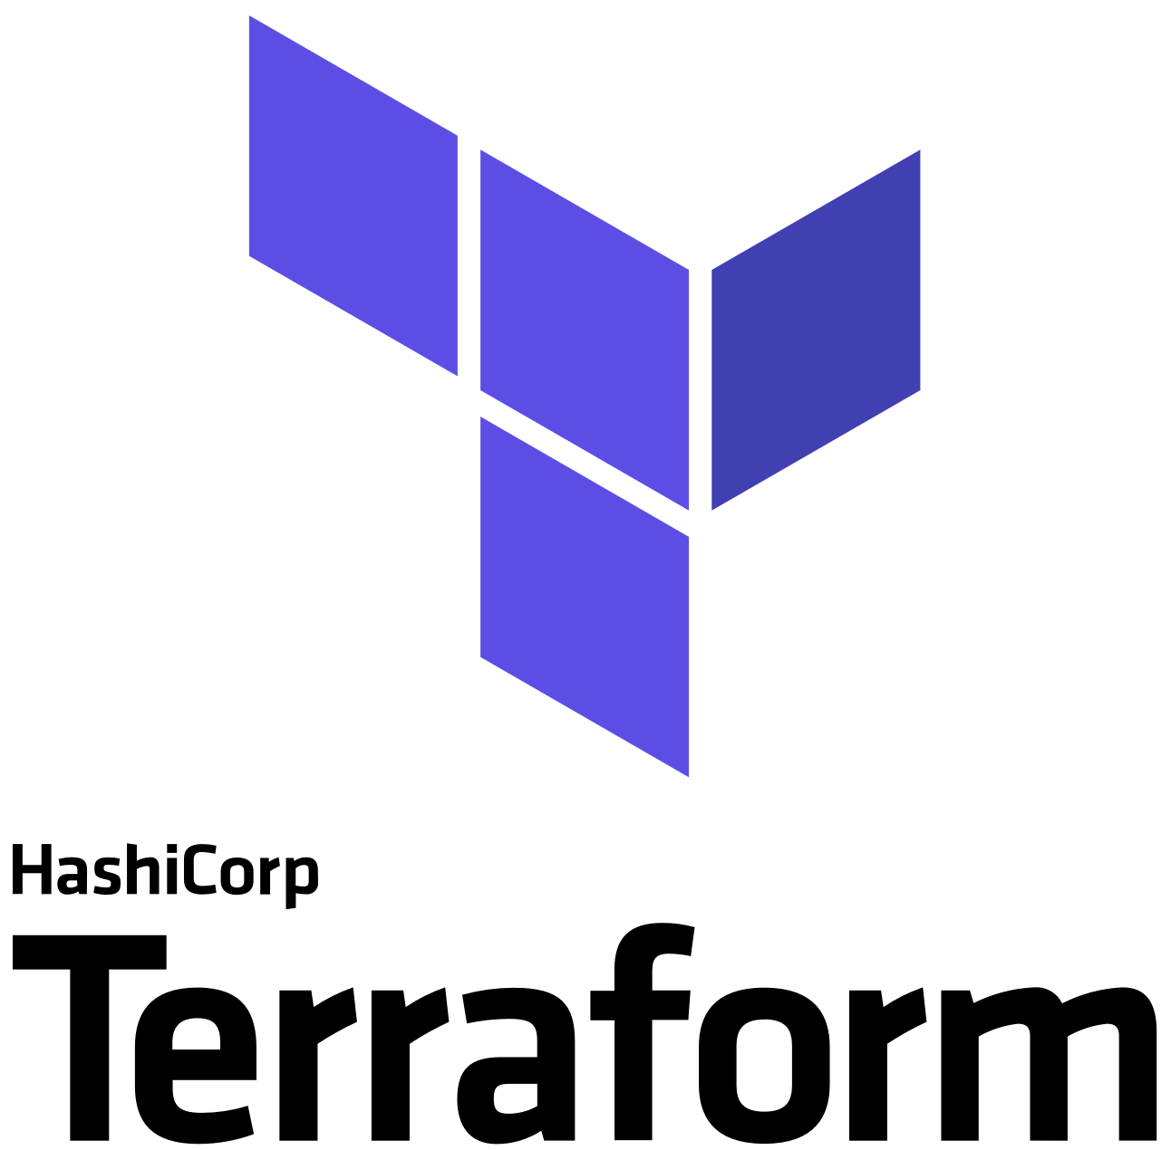
Terraform
Infrastructure as Code
Execution Plans
Resource Graph
Change Automation
Terraform file and immutable infrasturctures
Notes:
幾乎可用於所有平台或雲服務
允許表示從硬體, 虛擬機一路到郵件與DNS的所有內容 且與其他系統互不相斥
基礎架構即代碼（Infrastructure as Code 執行計劃（執行計劃） Terraform有一個計劃步驟，它生成一個執行計劃。執行計劃顯示了當執行apply命令時Terraform將要什麼。
通過計劃進行提前檢查，可以使Terraform操作真正的基礎結構時避免意外。 資源圖（資源圖） Terraform構建的所有資源的圖表，它能夠並行地創建和修改任何沒有相互依賴的資源。
因此，Terraform可以高效地構建基礎設施，操作人員也可以通過圖表深入地解其基礎設施中的依賴關係。 自動化變更（Change Automation） 把複雜的變更集應用到基礎設施中，而無需人工交互。
通過執行計劃和資源圖，我們可以確切地知道Terraform將會改變什麼，以什麼順序改變，從而避免許多可能的人為錯誤。

Slide 22
Resource Manager

Slide 23
What is Resource Manager
Provide a consistent management layer
Create, update, and delete resources in user's Azure subscription
Control, auditing, and tagging features
Secure and organize user's resources
Notes:
提供一致管理層
建立, 更新, 刪除資源
控制, 稽核, 標記
保護與組織資源

Slide 24
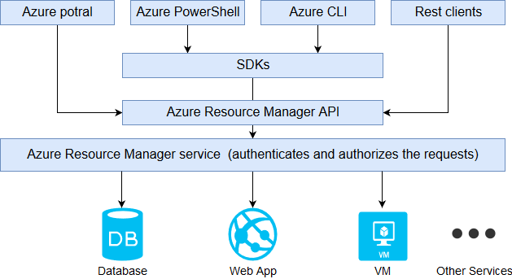
What is Resource Manager
Notes:
關於Azure Resource Manager API
各方都由相同API處理，所以不同工具仍有同樣的結果與功能

Slide 25
Advantage
Deploy, manage, and monitor all the resources as a group
Repeatedly deploy your solution
Manage your infrastructure by templates rather than scripts
Define the dependencies between resources
Apply access control to all services in your resource group
Apply tags to resources
Notes:
以群組形式部屬,管理,監視所有資源，而非個別管理
可在方案周期持續數方案，確保資源部屬為一致狀態
以範本而非指令碼來管理基礎結構
定義資源間的相依性，確保資源部屬順序正確
可將存取控制套用至資源群組中的所有服務
可在資源上套用標籤
可檢視同標籤之資源與資源群組

Slide 26

ARM templates
Define the infrastructure that needs to be deployed
An infrastructure as code
Automate deployments
Any one can run the code and deploy similar environments
A JavaScript Object Notation (JSON) file that defines the infrastructure and configuration

Slide 27
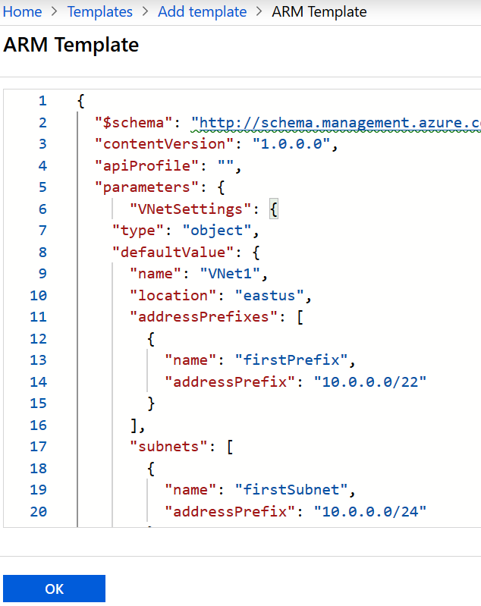
ARM Template
Defines the infrastructure and configuration of Azure solution
Consists of JSON and expressions
You can use a single template to deploy the entire application
You can divide an application to many purpose-specific templates
Use the template for updates to the infrastructure
Becomes part of the source code for your app
Notes:
定義Azure方案的基礎結構
使用JSON與與運算式為基本語法
可由單一範本定義整個結構
可將整個結構分為多個特定目的的範本
可由範本進行基礎結構的更新
會成為應用程式原始碼的一部份
可由範本進行重複部屬，不須重新定義資源環境

Slide 28


ARM templates Advantage
Declarative syntax
Repeatable results
Orchestration
Built-in validation
Tracked deployments
CI/CD integration

Slide 29
What is Azure Automation

Slide 30
What is Azure Automation
Automation and configuration service across Azure and non-Azure
Without having to use a virtual or physical machine
Automation service consists of
Process automation
Configuration management
Update management

Slide 31
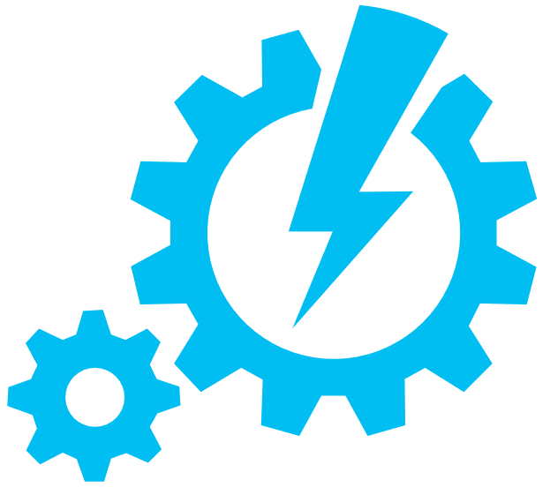
Azure Automation Account
Use Azure Automation must create at least one Automation account
Isolate Automation resources
Runbooks
Assets
Configurations
Must authenticate to Azure using Azure Active Directory

Slide 32

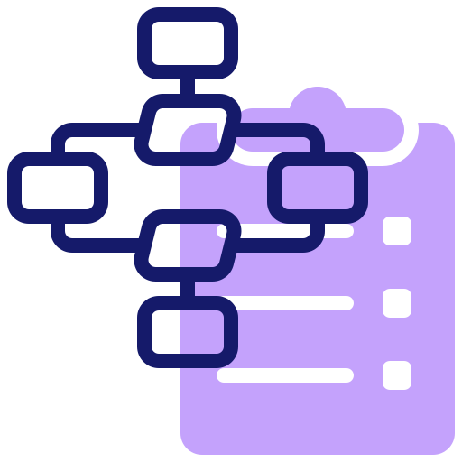

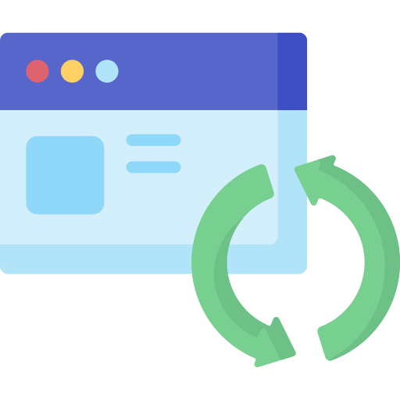


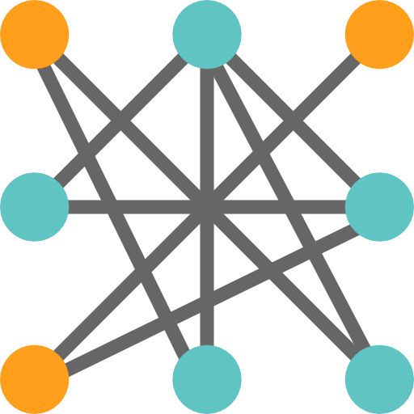

Common scenarios
Process
Automation
Configuration
Management
Update
Management
Shared
capabilities
Heterogeneous

Slide 33
Process Automation

Slide 34

Process automation
Shared
Module
Python package
Variable
Connectivity
Credentials
Certificates
Connections
Runbook A
Runbook B
Runbook C
VM

Slide 35
Azure Runbook

Slide 36
Advantages
Same infrastructure
Automatic deploy and expansion by Azure
Infrastructure as Code
Only maintain the script

Slide 37

Infrastructure as Code (IaC)
System
Behavior
Easy to rebuild
Processed in any way
Every system is consistent
Can be repeated
Can change elastically
Notes:
將基礎設施作為代碼，版本管理起來，強調多個系統及其配置在改變時具有一致性, 可重複。
系統可輕鬆重建: 能輕鬆可靠的重現設施內的任何元素
系統可任意處理: 可隨意新增, 刪除, 修改, 移動資源
各個系統皆一致: 除了區分身分的IP之外幾乎完全相同
各行為皆可重複: 基於第一項可重建原則的結果
設計可彈性變化: 確保系統能安全, 迅速, 頻繁的變化

Slide 38
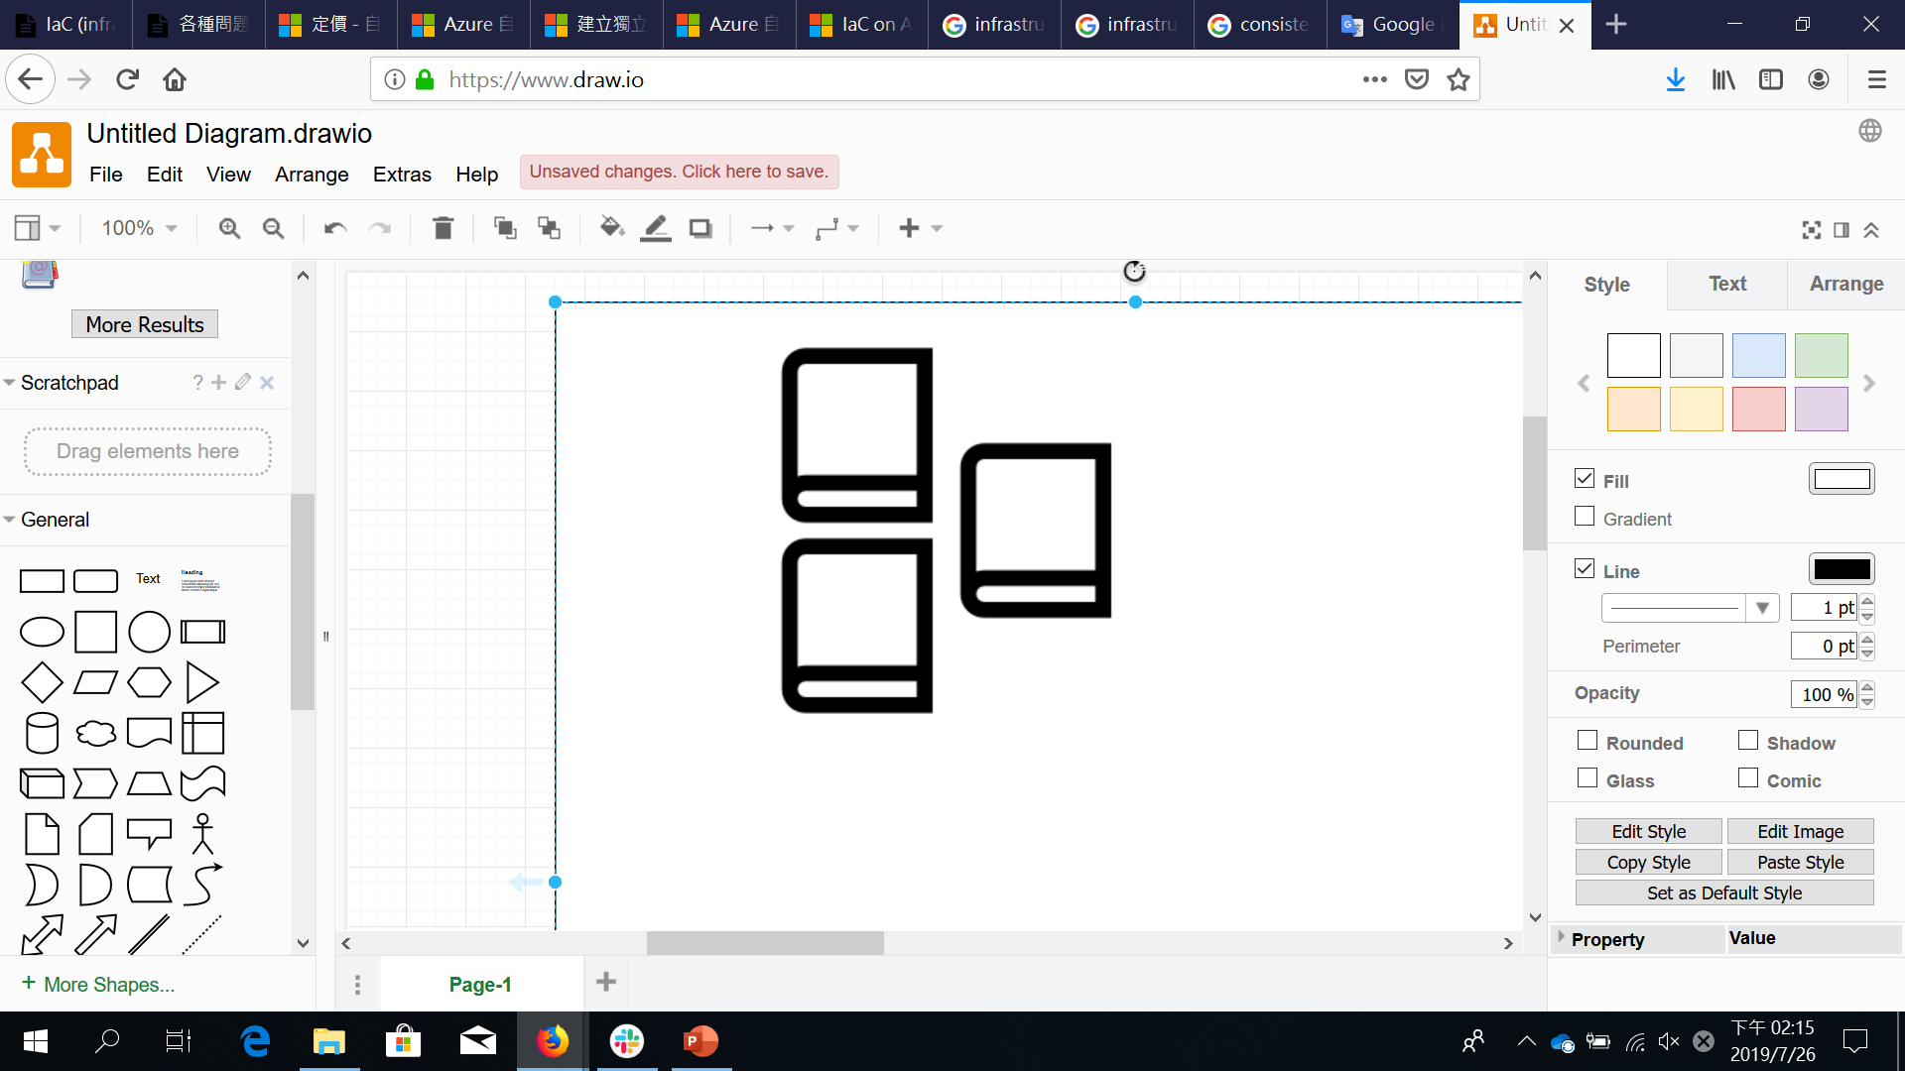

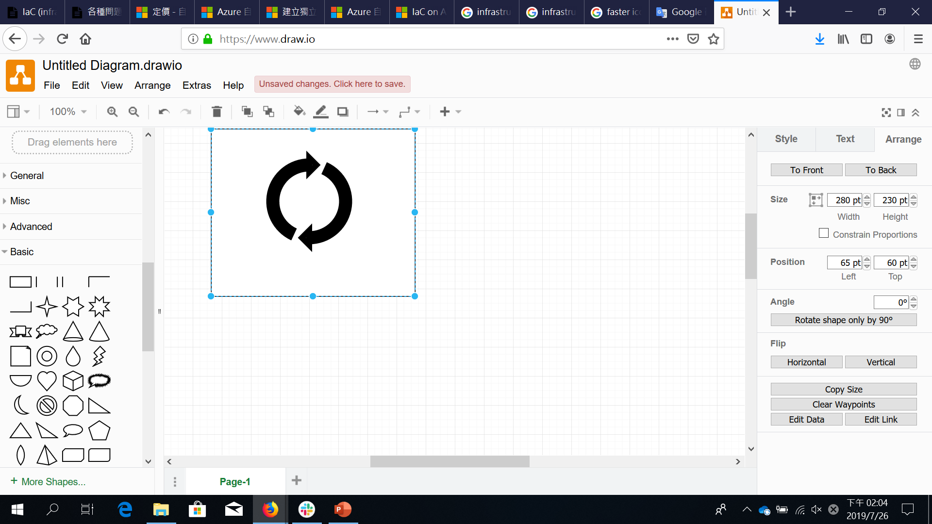
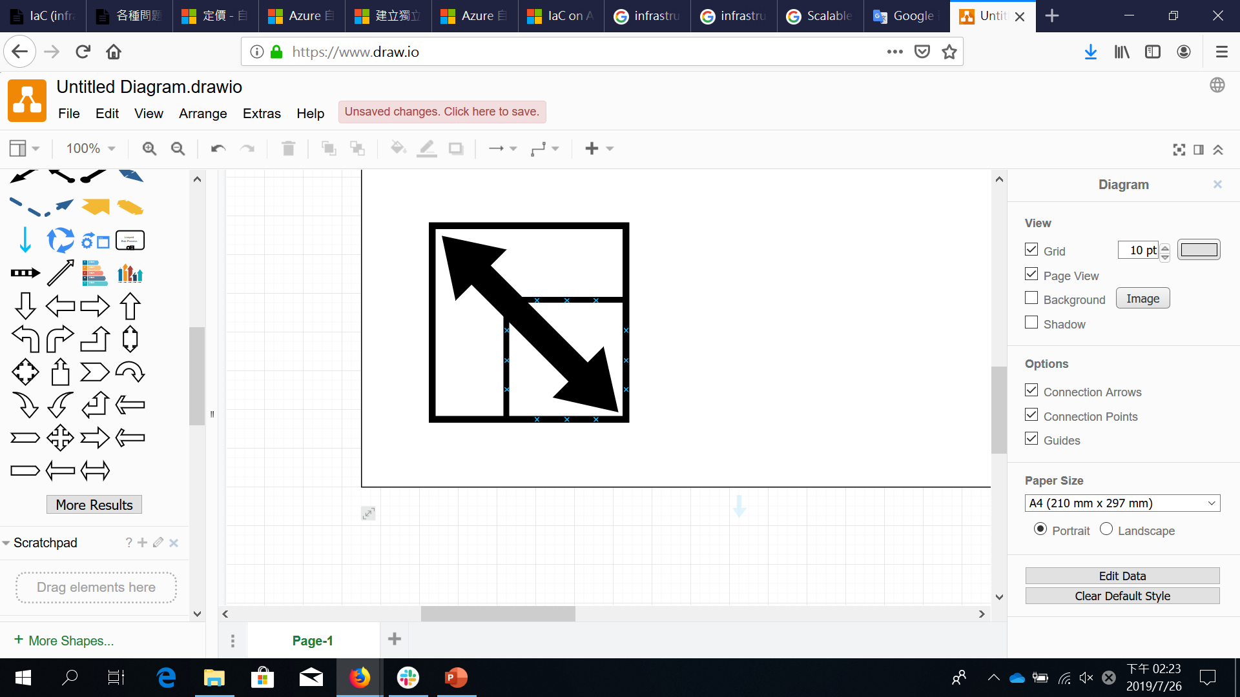
Infrastructure as Code (IaC)
Consistency
Accelerating
Reusability
Extensibility
Notes:
一致性
不變地實現標準化配置與部署
加快
加速配置與部署
可重複性
可重複使用的JSON代碼，用於可重複或類似的配置與部署
可擴展性
可擴展的JSON代碼 用於合併其他項目

Slide 39
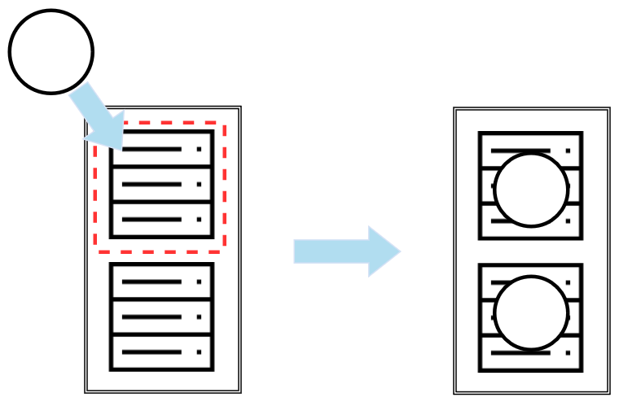
IaC - Updating
V . 2
V . 2
V . 2

Slide 40
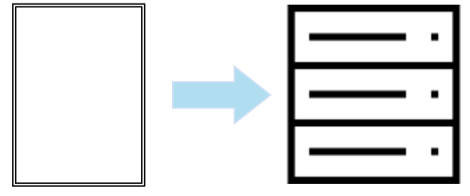

IaC and Runbook
Script
with
IaC Rule
Runbook

Slide 41
Type
Graphical
Graphical PowerShell Workflow
PowerShell
PowerShell Workflow
Python
Notes:
圖形化
以 Windows PowerShell 為基礎，而且完全在 Azure 入口網站的圖形化編輯器中建立和編輯。
圖形化 PowerShell 工作流程
以 Windows PowerShell 工作流程為基礎，而且完全在 Azure 入口網站的圖形化編輯器中建立和編輯。
PowerShell
以 Windows PowerShell 指令碼為基礎的文字 Runbook。
PowerShell 工作流程
以 Windows PowerShell 工作流程為基礎的文字 Runbook。
Python
以 Python 為基礎的文字 Runbook。

Slide 42
Graphical Runbooks
Can be exported to files and imported into another account
Generate PowerShell code
Can be converted to PowerShell

Slide 43
PowerShell Runbooks
Implement complex logic with PowerShell Workflow code
Use checkpoints to resume operation if there's an error
Use parallel processing to do multiple actions in parallel
Include other graphical runbooks and PowerShell runbooks

Slide 44
Python runbooks
Compile under Python 2
Use the robust Python libraries
Can run in Azure or on Linux Hybrid Runbook Workers

Slide 45
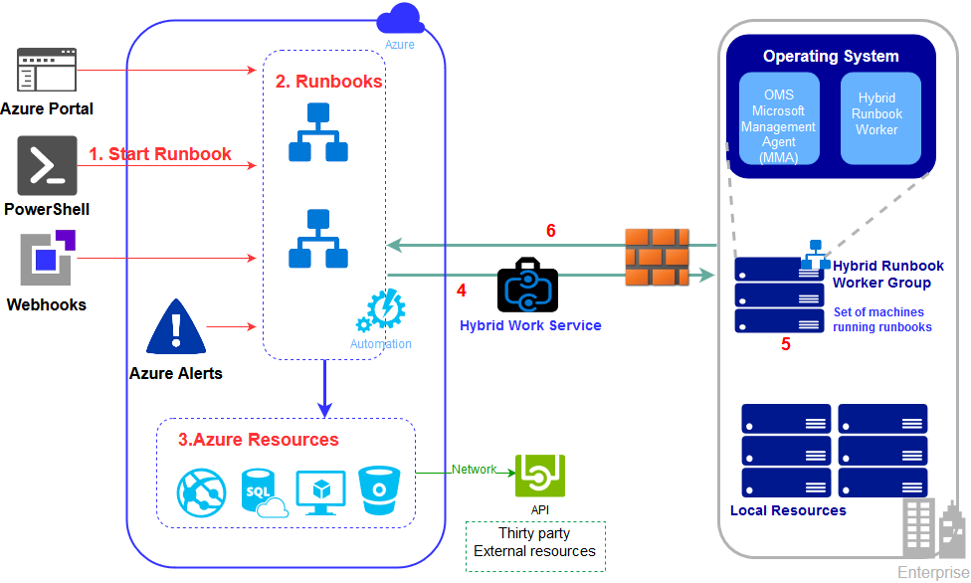
Notes:
Start a runbook.
Azure automation notes that a Runbook should be started.
Cloud resources – Runbook acts on local Azure resources or other external resources reachable via the network.
On-premises – Hybrid runbook group sends the runbook to an on-permises machine to run.
Runbook acts on its network resources.
Job results are returned

Slide 46
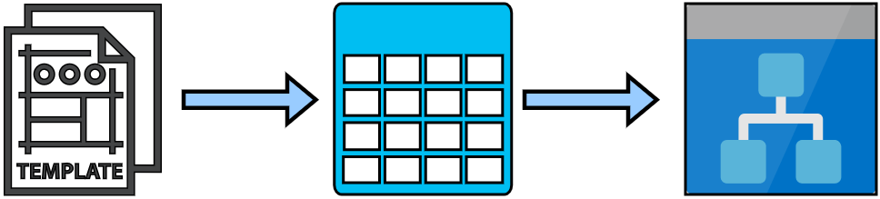
Runbook and Resource Manager Template
Resource Manager
Template
Storage
Runbook
Notes:
將Resource Manager的範本放置於儲存體中
在Runbook中連接儲存體並透過指令取得範本(匯入範本)
利用儲存體與Runbook自動化來做到環境自動部屬
備註: 細節由PowerShell指令控制 在此不贅述

Slide 47
Configuration Management

Slide 48



Configuration Management
Configuration Management in Azure Automation allows access to two features:
Change Tracking and Inventory
State Configuration

Slide 49


Change Tracking and Inventory
Tracks changes in virtual machines and server infrastructure
Software managed by the Package Manager
Collect data from Log Analytics agents
Service tracked data:
Windows software
Linux software (packages)
Windows and Linux files
Windows registry keys
Microsoft services
Linux daemons
Notes:
追蹤虛擬機器和伺服器基礎結構中的變更，以協助您找出散發套件管理員所管理之軟體的操作和環境問題。 變更追蹤和清查追蹤的專案包括：
Windows 軟體
Linux 軟體（套件）
Windows 和 Linux 檔案
Windows 登錄機碼
Microsoft 服務
Linux 精靈
從 Azure 監視器取得其資料。 連線至 Log Analytics 工作區的虛擬機器會使用 Log Analytics 代理程式，來收集已安裝軟體、Microsoft 服務、Windows 登錄和檔案，以及受監視伺服器上任何 Linux 守護程式變更的相關資料。

Slide 50
Change Tracking and Inventory user interface
Selecting one of the add VMs options

Slide 51
State Configuration
Compile PowerShell Desired State Configuration(DSC)
Configurations for nodes in any cloud or on-premises datacenter
Built-in pull server
Management of all your DSC artifacts
Import of reporting data into Azure Monitor logs

Slide 52
Desired State Configuration
Use a PowerShell-based scripting language to configure Windows and Linux systems
Two different models:
Push model
Pull model

Slide 53
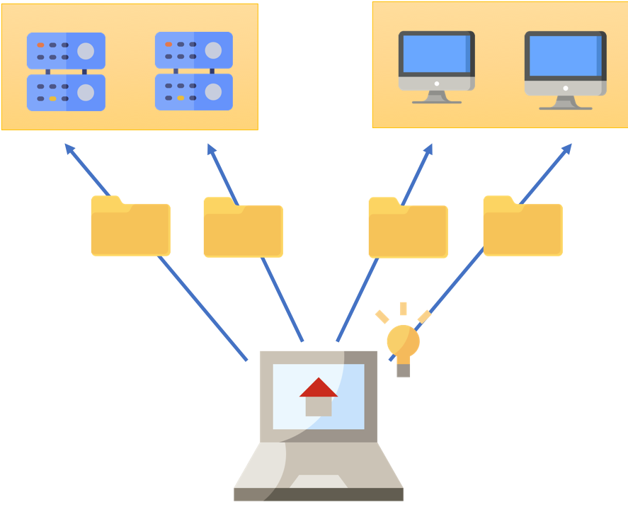
Push model
Manually towards one or more units that call node
Administrator sends the configuration to the machines
Not necessary to invest in a new serve
The simplicity of the architecture

Slide 54
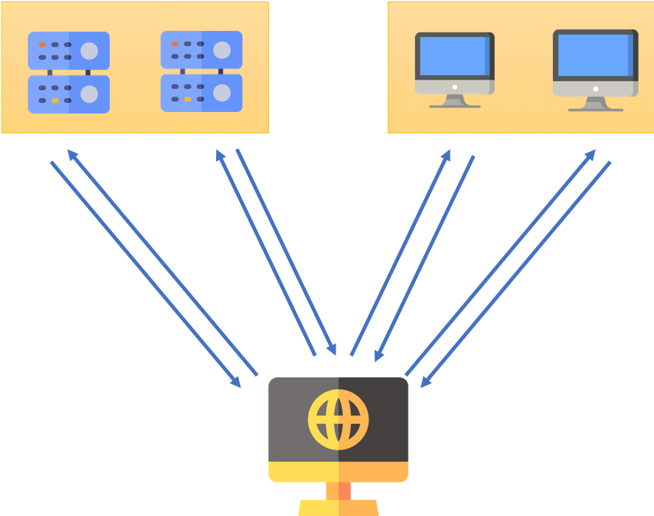
Pull model
Nodes contact server at regular intervals so as to obtain their configuration
Automation of the deployment of the configurations
Management of numerous machines

Slide 55
Update management

Slide 56
Update management
Manage operating system updates for Windows and Linux machines
Manage installing required updates for servers
Use Azure Monitor and Log Analytics Workspace to collect information
Work with computer in Azure, on-premises or other cloud platform

Slide 57
Update Management to connected Server work

Slide 58


Update Classification
Windows
Critical Updates
Security Update
Update Rollups
Feature Packs
Service packs
Definition Updates
Tools
Updates
Linux
Critical and security Updates
Other updates

Slide 59
Enable Update Management for Azure virtual machines

Slide 60
View results of an update deployment

Slide 61
Shared capabilities

Slide 62
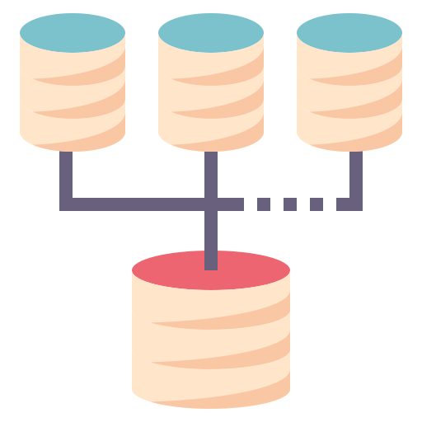

Shared capabilities
Offers shared capabilities including :
shared resources
role-based
access control
flexible scheduling
source control integration
Auditing and tagging
Role-based access control

Slide 63








Shared resources
Schedules
Modules
Modules gallery
Python 2 packages
Credentials
Connections
Certificates
Variables

Slide 64
Role-based access control
Manage who has access to Azure resources, what they can do with those resources, and what areas they have access to
An authorization system built on Azure Resource Manager
Roles assigned at a higher scope, are inherited by child scopes
Such as "Read-only" or "Contributor"

Slide 65
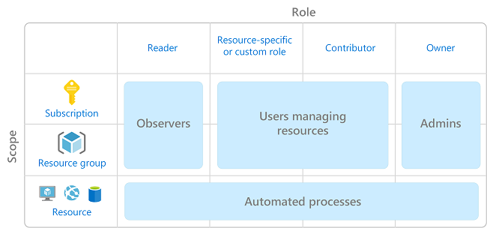
Role-based access control
Notes:
僅授與使用者執行作業所需的存取權。 可以不授與每個人 Azure 訂用帳戶或資源中無限制的權限，而是只允許在特定範圍執行特定的動作。

Slide 66
Role based access control
Access management for Azure resources
Access they need to perform their jobs
Assigning the appropriate RBAC role to Automation account scope

Slide 67
Use Cases for Automation on Azure

Slide 68
VM management
Use Azure automation to deploy VMs and schedule the startup and shutdown of instances

Slide 69
Configuration management
Use Desired State Configuration on servers to enforce consistent settings across instances

Slide 70
Log management
Run log analytics and generate reports

Slide 71
Database management
Truncate databases and perform scheduled exports and backups

Slide 72
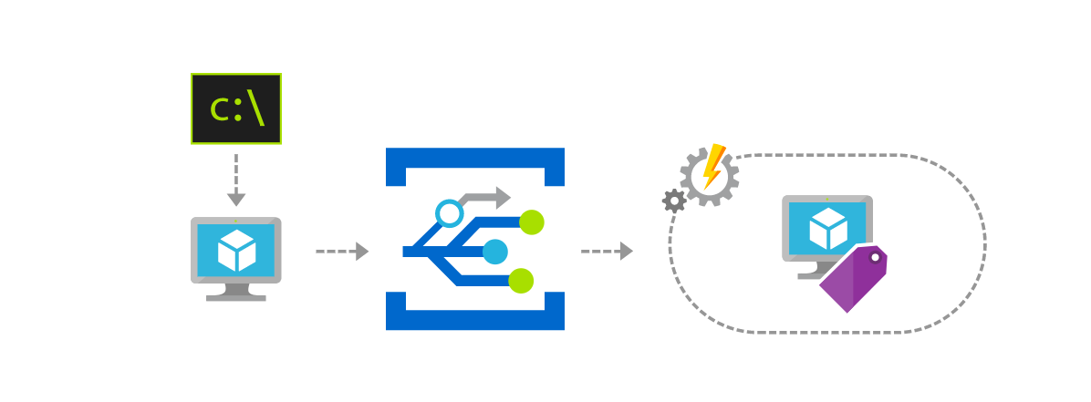
Event management
These events can be used to automatically check that service configurations are compliant

Slide 73
Lab time

Slide 74


Lab time
『Deploy Linux VM by Resource Manager Template in Azure Automation』
『Start/Stop VMs during off-hours solution in Azure Automation』
『Linux VM patch update by Update Management in Azure Automation』

Slide 75
Conclusion

Slide 76
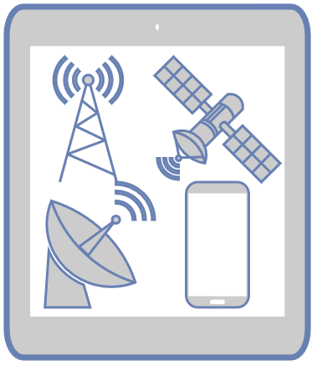
Azure Automation is Reliable and Useful

Slide 77
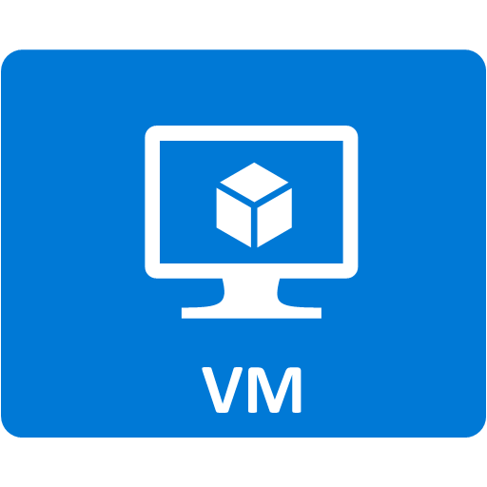

Choosing the Service you need
Automation
By Yourself

